Slide 1
STOCK PRICE PREDICTOR
Using LSTM Model

Slide 2

Stock Market is full of uncertainties.
So, There can not be a perfect model for prediction of stock price of every company. We need to develop models which suits to almost every data with more accuracy.

Slide 3
PROBLEM STATEMENT
The challenge of this project is to accurately predict the future closing value of a given stock across a given period of time in the future. For this project we will use a Long Short Term Memory networks – usually just called “LSTM” to predict the closing price of the S&P 5001 using a dataset of past prices.
Historical data is a timeseries data and problem is type of sequence prediction.

Slide 4
GOALS
Explore stock prices.
Preprocess the data.
Implement LSTM using keras library.
Evaluate the performance of model and update the Model.
Compare the results and submit the report.

Slide 5
LONG SHORT TERM MEMORY NETWORK(LSTM)
Long Short-Term Memory (LSTM) networks are a type of recurrent neural network capable of learning order dependence in sequence prediction problems.
Long Short-Term Memory (LSTM) can solve numerous tasks not solvable by previous learning algorithms for recurrent neural networks (RNNs).
LSTM overcome the technical problems of vanishing gradient descent.

Slide 6
PREDICTION MODEL

Slide 7
DATASET
The data used in this project is of the Alphabet Inc from January 1, 2005 to June 20, 2017, this is a series of data points indexed in time order or a time series.
The dataset is of following form :
Date | Open | High | Low | Close | Volume
30-Jun-17 | 943.99 | 945.00 | 929.61 | 929.68 | 2287662
29-Jun-17 | 951.35 | 951.66 | 929.60 | 937.82 | 3206674
28-Jun-17 | 950.66 | 963.24 | 936.16 | 961.01 | 2745568

Slide 8
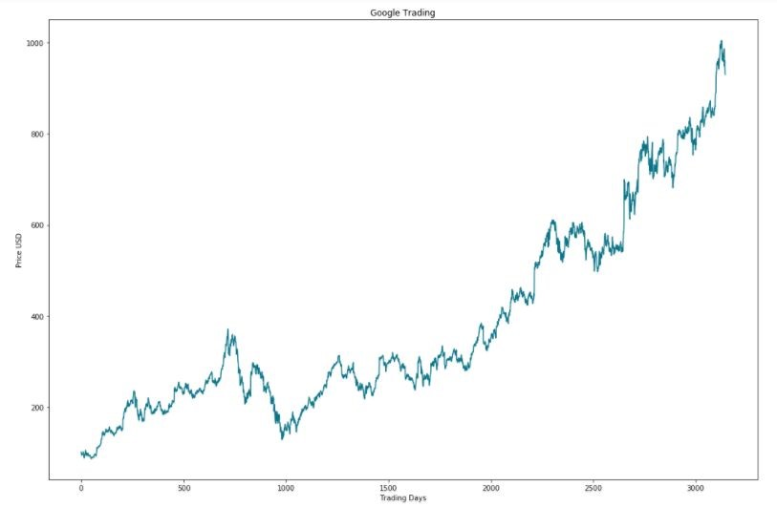
X-axis: Represents Tradings Days Y-axis: Represents Closing Price In USD

Slide 9
PREPROCESSED DATA
Item | Open | Close | Volume
0 | 0.012051 | 0.015141 | 0.377248
1 | 0.014198 | 0.010658 | 0.325644
2 | 0.009894 | 0.010112 | 0.189820
3 | 0.010874 | 0.007407 | 0.242701
Splitted the dataset into the training and test datasets for LSTM model. The Split was of following shape:
x_train (2589, 50, 3)
y_train (2589,)
x_test (446, 50, 3)
y_test (446,)

Slide 10
MODEL PARAMETERS (INPUT AND TRAINING)
Neural Network Architecture
Number of Layers (how many layers of nodes in the model; used=3)
Number of Nodes (how many nodes per layer; used=128; tested with=1,3,8, 16, 32, 64, 100)
Epochs (how many times to run through the training process; kept at 10 for optimal results ; tested with=1,5,8,20)

Slide 11
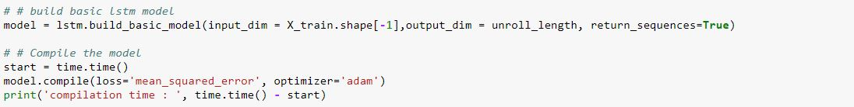
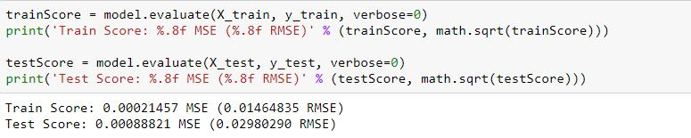

Slide 12
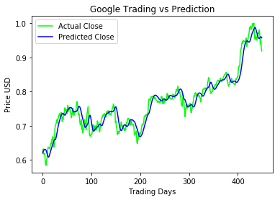
Fig: Plot of Long-Short Term Memory Prediction model (epochs=10)

Slide 13
CONCLUSION
There are several Model which suits to our problem
Support Vector Machine (SVM)
Random Forest
Multi-layer perceptron
We would choose our final model visualization, which is LSTM by fine tuning parameters. As we were very impressed on seeing how close we have gotten to the actual data, with a mean square error of just 0.0009.

Slide 14
USE OF THIS MODEL
This model can be used for various type of prediction problems. Like-
Weather prediction
Product price prediction
Solar data prediction
Value of currency prediction
Etc.

Slide 15
FUTURE SCOPE OF THIS MODEL
We are going to deploy this model to a web portal open for users which will work on the review system.
We are working to connect this model directly to Google finance api.
User can select the company for which he wants to predict future closing prices.
He can choose among thousands of stocks.
Web portal will also show the possibly profitable and dangerous stocks of and most .
We will upload this project on github for future development by others.

Slide 16
Thank You!

